Slide 1
Lumerical Learning Process

Slide 2
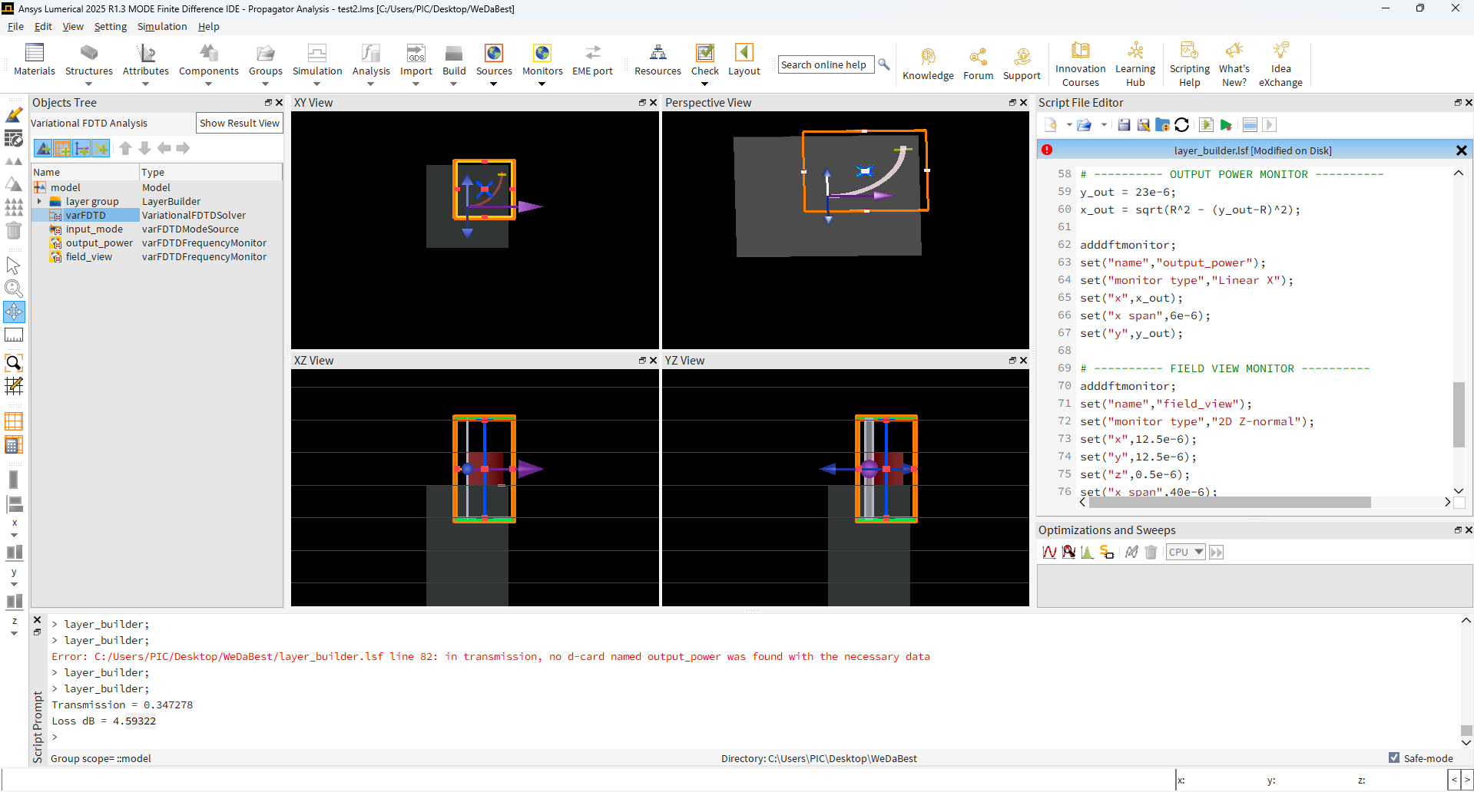
Starting With The Basics (MODE)
Starting with the GUI
Learn how to create structures
Define geometry
Define material
Learn how to create sources + ports
Define each type
I.e. Mode
I.e. Frequency Domain

Slide 3
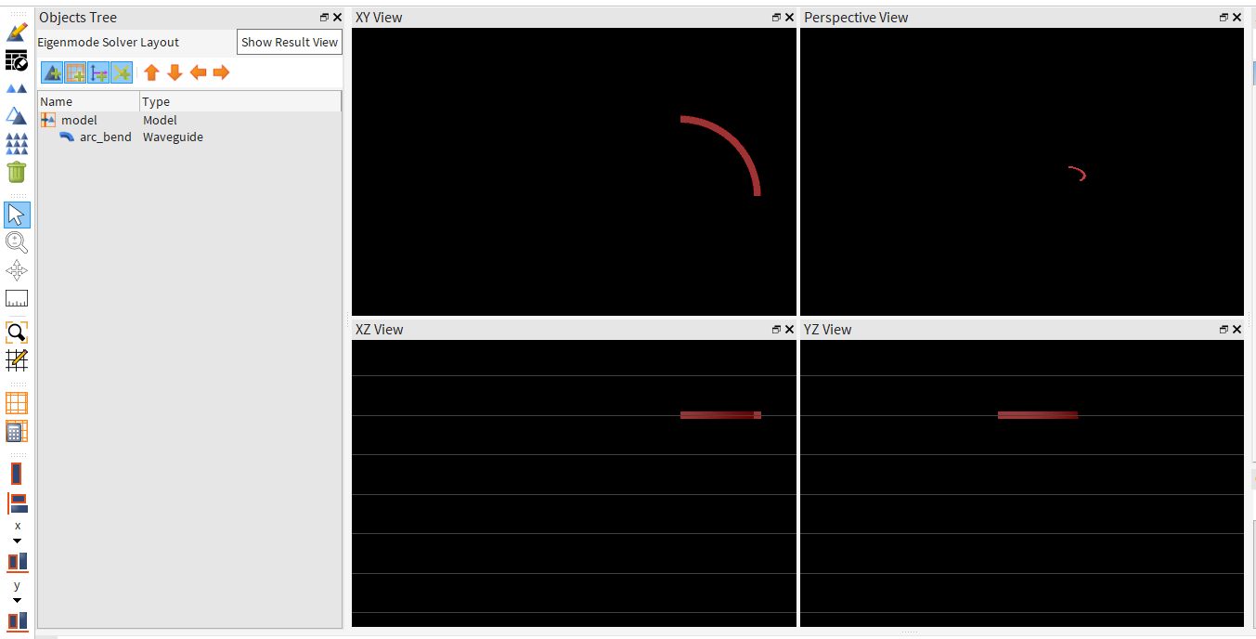
First Waveguide!!!

Slide 4
Learned Procedure
Define structure
Define inputs + outputs
Simulate and find s-parameters

Slide 5
Learning Layer Builder
Use .gds to define 2D layout structure
Use .lsf to define object
Including Layer builder
General structures (waveguide, rectangle, monitors, etc)
Running
Either in Lumerical GUI
Or scripting in python and calling the lumapi

Slide 6
Building Our First Curved Waveguide
Procedure
Create a .gds file with python
Generate a sequence of points
Combine to form a polygon and export to .gds format
View with klayout
Import .gds into the .lsf
Use .lsf to generate the layout builder object and help to simulate performance

Slide 7
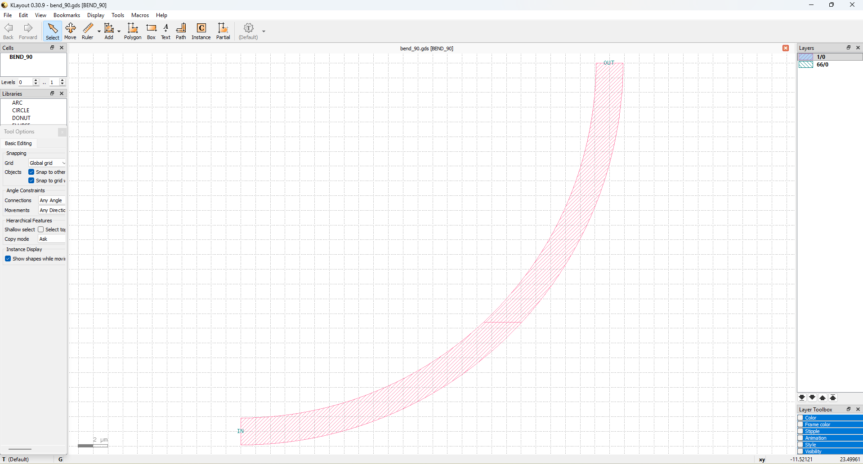

Slide 8
Simulating Performance Of Our First Waveguide
Procedure
Add ports + monitors
In the .lsf add the objects
Add the FDTD region + mesh
Run procedure + performance metric display

Slide 9
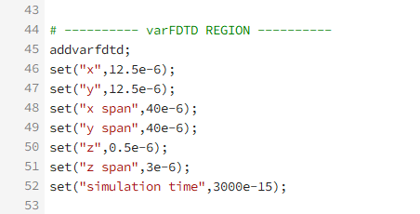
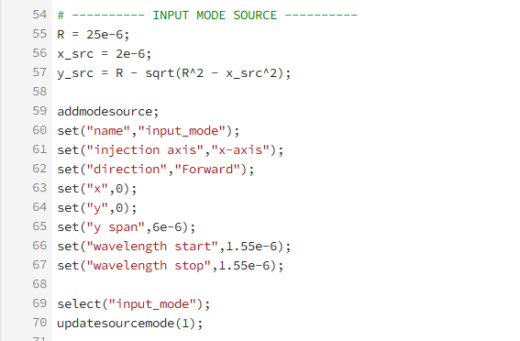
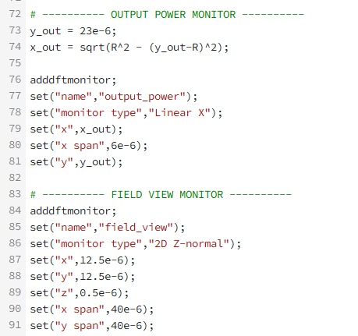
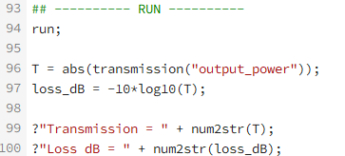

Slide 10
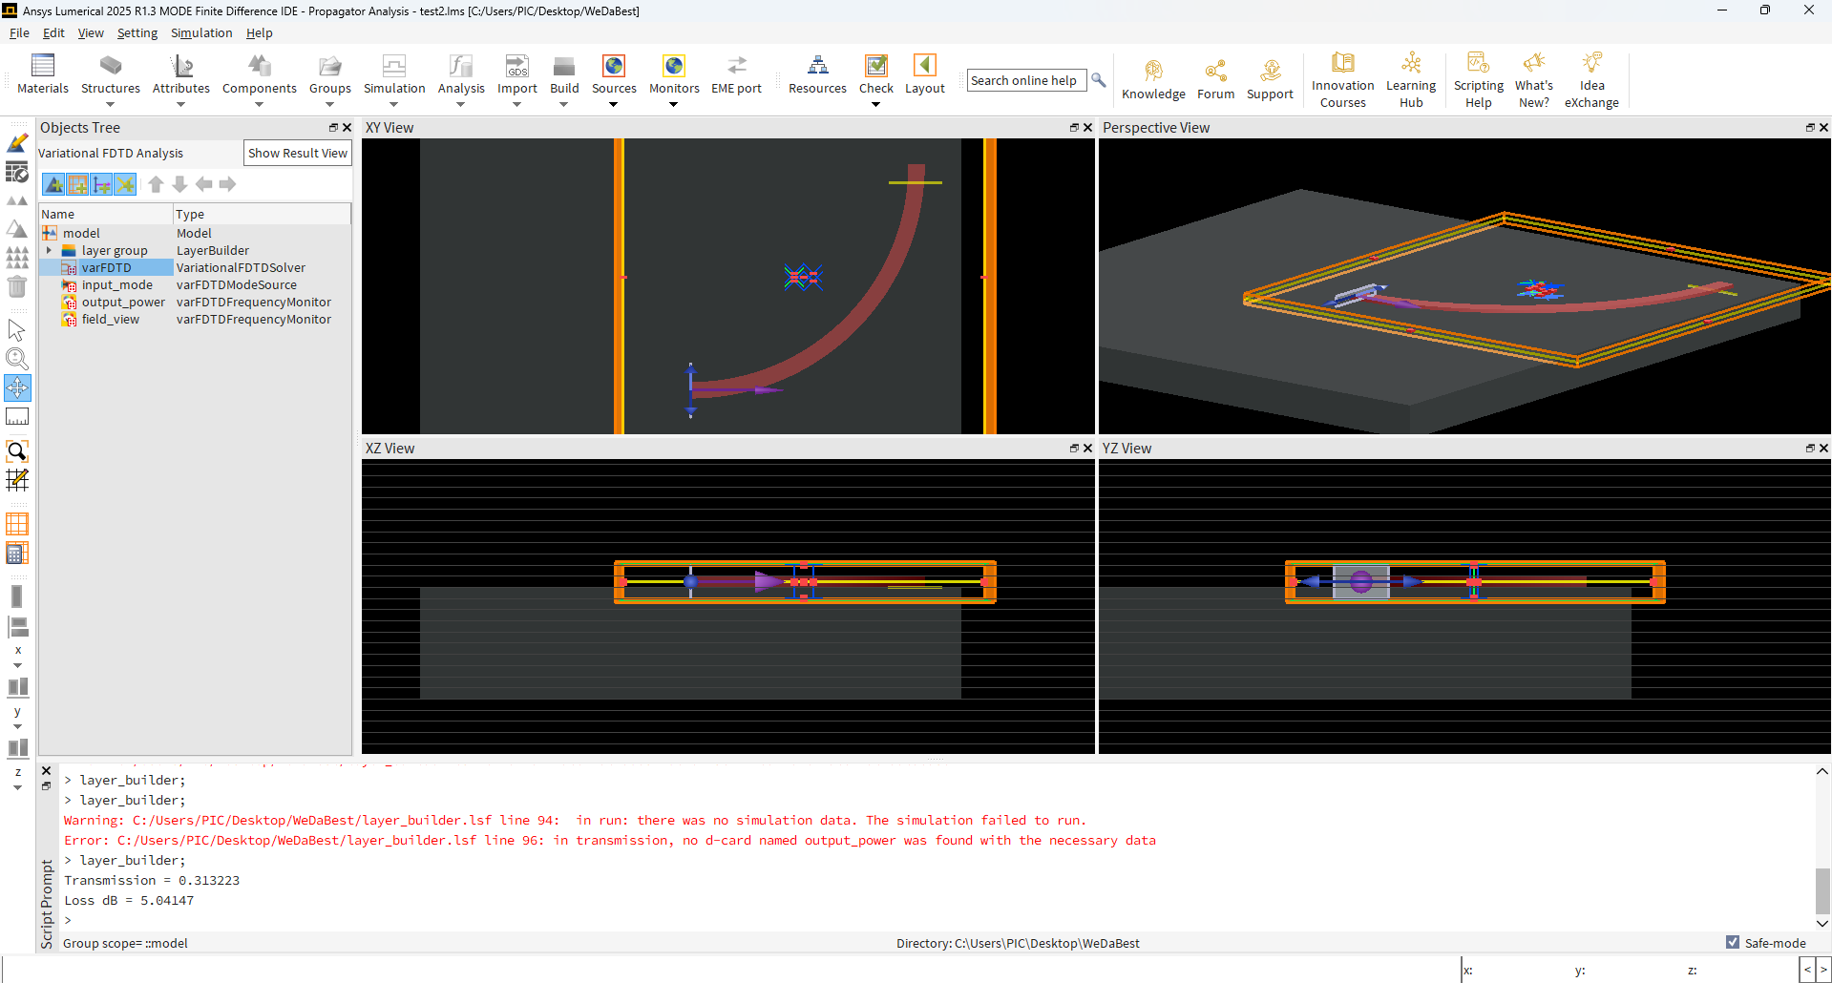
Simulating Performance Of Our First Waveguide
Results!!!
Loss
5 dB!!!
We start improving from here

Slide 11
Generating our First Material (LN)
Just add to the material database/catalogue

Slide 12
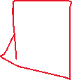
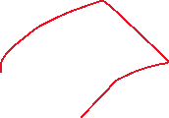
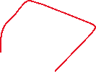
Performing Our First Optimization
Rough idea
Use Lumopt to optimize several segments of the waveguide bend
We used 8 segments of varying radii and optimized for the best combination of them
Result
The simulated connections between the different segments were not handled well as a result the best combination turned out to be the same seeded value (smoothed 25 um radius)
Loss maintained at 5 dB

Slide 13
Performing Our First Optimization
Learning
We need to design a better approach for the waveguide design before optimization such that the parameters work

Slide 14
Code
In the notes
Notes:
import sys
import os
import numpy as np
import scipy as sp
sys.path.insert(0, r"C:\Program Files\ANSYS Inc\v251\Lumerical\api\python")
sys.path.insert(0, r"C:\Users\PIC\Desktop\WeDaBest\LumOpt")
from lumopt.utilities.wavelengths import Wavelengths
from lumopt.geometries.polygon import FunctionDefinedPolygon
from lumopt.figures_of_merit.modematch import ModeMatch
from lumopt.optimizers.generic_optimizers import ScipyOptimizers
from lumopt.optimization import Optimization
# ---------- PARAMETERS ----------
R = 25e-6 # bend radius
W = 1.83e-6 # waveguide width
H = 1.0e-6 # waveguide thickness
n_bg = 1.44 # SiO2
n_ln = 2.20 # scalar LN approximation for optimization
wavelengths = Wavelengths(start=1550e-9, stop=1550e-9, points=1)
base_script = os.path.join(os.path.dirname(__file__), "base.lsf")
# ---------- OPTIMIZABLE 90 DEGREE BEND ----------
num_params = 8
theta_ctrl = np.linspace(-np.pi / 2, 0, num_params + 2)[1:-1]
initial_params = R * np.ones(num_params)
bounds = [(R - 4e-6, R + 4e-6)] * num_params
def bend_polygon(params=initial_params):
"""Return CCW polygon points for a variable-radius 90-degree bend."""
theta_all = np.concatenate(([-np.pi / 2], theta_ctrl, [0]))
r_all = np.concatenate(([R], params, [R]))
interp = sp.interpolate.interp1d(theta_all, r_all, kind="cubic")
theta = np.linspace(-np.pi / 2, 0, 160)
r = interp(theta)
r_outer = r + W / 2
r_inner = r - W / 2
# Circle center is at (0, R)
outer = np.column_stack((r_outer * np.cos(theta),
R + r_outer * np.sin(theta)))
inner = np.column_stack((r_inner * np.cos(theta[::-1]),
R + r_inner * np.sin(theta[::-1])))
points = np.vstack((outer, inner))
# force counter-clockwise orientation
x = points[:, 0]
y = points[:, 1]
area = 0.5 * np.sum(x * np.roll(y, -1) - y * np.roll(x, -1))
if area < 0:
points = points[::-1]
return points
geometry = FunctionDefinedPolygon(
func=bend_polygon,
initial_params=initial_params,
bounds=bounds,
z=0.5e-6,
depth=H,
eps_out=n_bg ** 2,
eps_in=n_ln ** 2,
edge_precision=5,
dx=1e-9
)
# ---------- FIGURE OF MERIT ----------
fom = ModeMatch(
monitor_name="fom",
mode_number=1,
direction="Forward",
multi_freq_src=False,
target_T_fwd=lambda wl: np.ones(wl.size),
norm_p=1
)
# ---------- OPTIMIZER ----------
optimizer = ScipyOptimizers(
max_iter=40,
method="L-BFGS-B",
scaling_factor=1e6,
pgtol=1e-9
)
# ---------- RUN ----------
opt = Optimization(
base_script=base_script,
wavelengths=wavelengths,
fom=fom,
geometry=geometry,
optimizer=optimizer,
use_var_fdtd=True,
hide_fdtd_cad=False,
use_deps=True
)
opt.init_plotter()
opt.plotter.movie = False
opt.run()

Slide 15
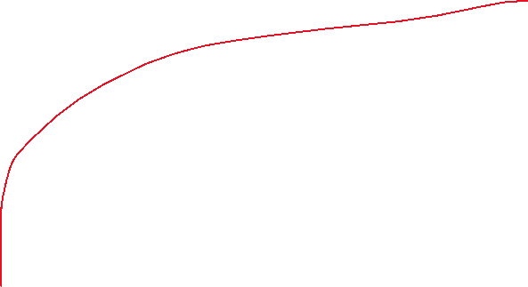
2nd Optimization Approach
Develop a better connection + segmented approach
Instead of fixing the center of the radius in space we will vary it
Optimizing the center line

Slide 16
Centerline Design Conditions
Curvature always increasing
The derivative of the interface should not exceed a constant
Otherwise decrease the merit function dramatically

Slide 17
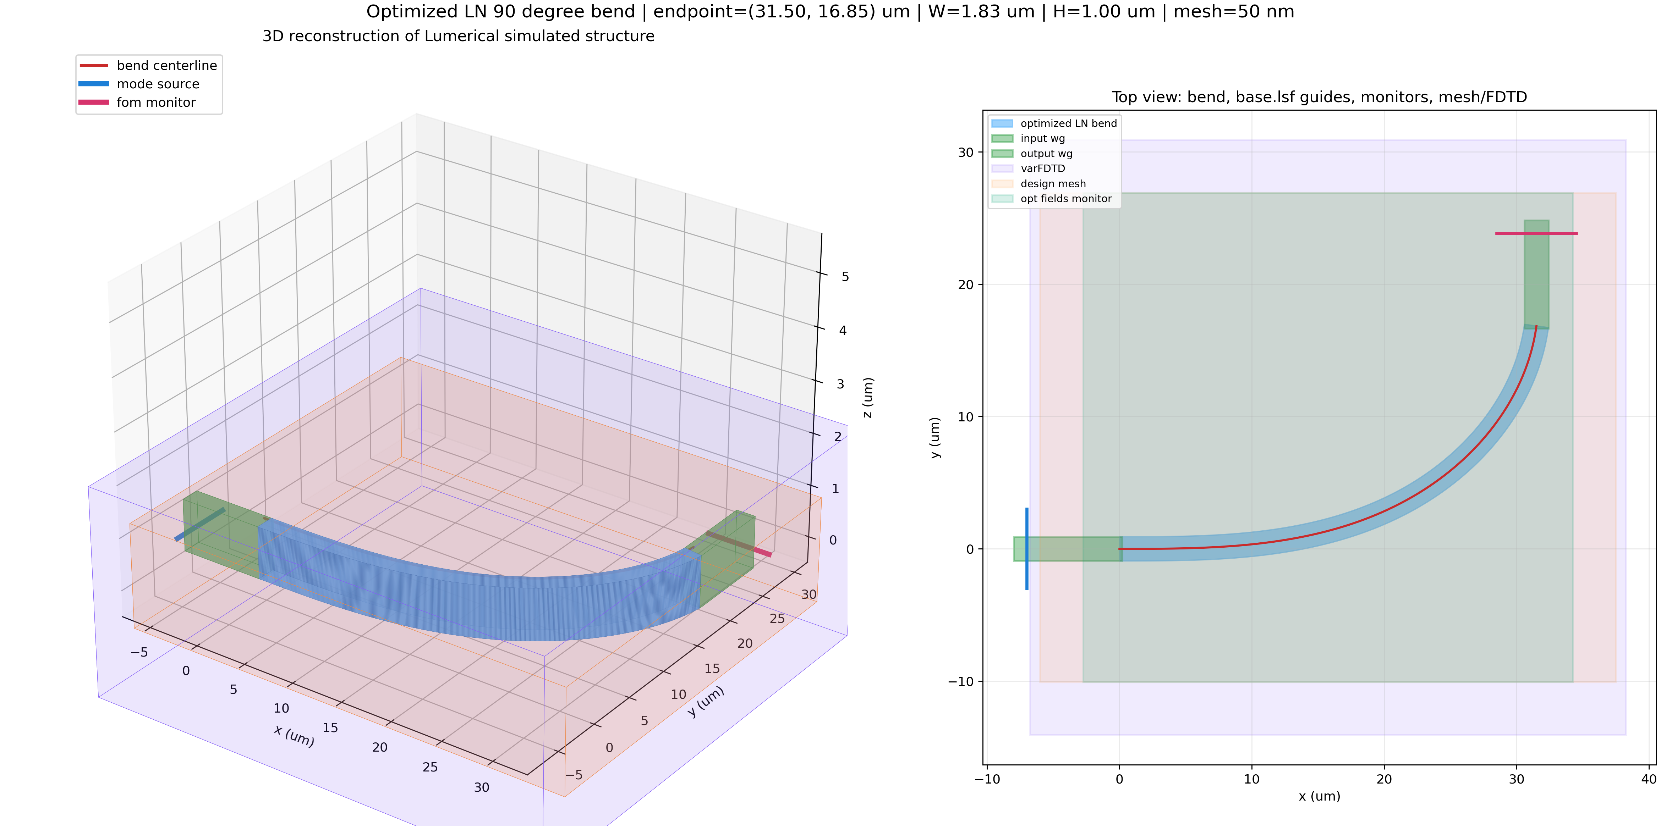
2nd Optimization Results
Notes:
Parameters
FINAL_PARAMETERS = np.array([
8, 8, 8, 8, 8, 8, 8, 8, 8, 8, 8, 8,
8, 8, 8, 8, 8, 8, 8, 8, 8, 8, 8, 8,
7.61722473, 8, 8, 7.15012409, 7.13035446, 7.28150568, 7.05481233, 7.01284343,
6.03618893, 5.65930189, 5.25973473, 5.42884294, 5.70837556, 4.34931513, 4.08031433, 3.77154924,
3.97284412, 3.19551698, 3.84706762, 2.87007739, 2.6051482, 3.30981182, 2.48654471, 1.58624323,
0.43604423, 1.58228282, 1.61901089, 1.64877403, 1.32884313, 0.20761352, 0.35015352, 1.79662236,
1.53864407, 0.66675978, -0.81190193, -0.89666845, 0.75307424, 0.69565405, -0.31614019, -0.71173202,
-0.09031953, 0.5942629, 0.86410944, 0.51041575, -0.37324764, -0.26461599, -0.22303369, 0.57406635,
1.60814363, 1.6465984, 1.2783256, 1.58787588, 0.47968965, 0.14519836, 1.67400531, 1.87038509,
1.68976327, 2.10630437, 2.18942169, 1.68427693, 2.61159037, 2.6765302, 3.02271604, 2.80814316,
2.81205414, 2.23836732, 3.63169119, 3.05323522, 3.38069699, 3.87437199, 4.12676747, 4.05052522,
4.35699329, 4.35016011, 4.5, 4.5
])

Slide 18
2nd Optimization Results
FOM = 0.012…
Loss
Undermined
Until the FDTD and Mode gets freed up
Conclusion is not great >10 db losses

Slide 19
Using FDTD Mode
Began using FDTD after simulating with the MODE viewer for prelim
Conclusions
Definitions of the components change from varFTDT to FTDT mode
i.e. addmonintor

Slide 20
Simulating Straight Waveguide (FDTD)
Using the following optimized parameters
0.9 um
0.3 um
70 degrees

Slide 21
Simulating + Optimizing For Straight Waveguide
Performance
0.04 db for 20 um …
Good enough for testing our bent geometry
0.9 um
0.3 um
70 degrees
LN
0.3 um
SiO2
4.7 um

Slide 22
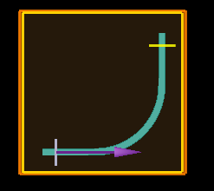
FDTD With Bent Continuous Waveguide
Continuous bending radius
10 um radius
Results
0.0551955 dB

Slide 23
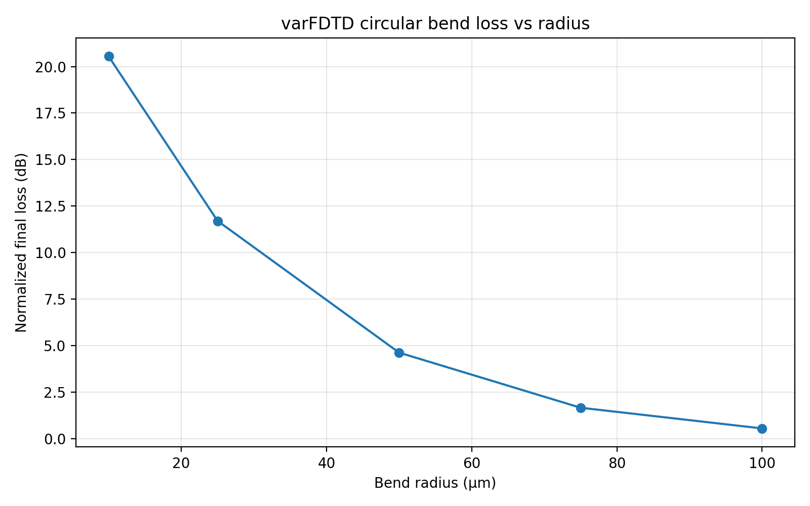
varFDTD With Varying Bent Waveguide Structrue
NOTE: I attempted many different times to attain the same loss results with the varFDTD with the FDTD, but always got much worse results with MODE. I.e. this demonstrated to me that it is generally impossible for this geometry because of the 3D surface… Additionally when we changed the sidewall angle from 70 – 90 degrees we saw >10db difference. This demonstrated that MODE (varFDTD ) used for bent structures is not accurate.
Conclusion
For more accurate simulation results FDTD mode is necessary

Slide 24
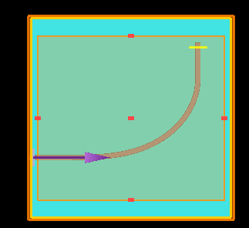
FDTD With Bent Optimized Waveguide
Varying curvature + smoothing
Results
Transmission = 0.0209516
Loss dB = 16.7878
Notes:
FINAL_PARAMETERS = np.array([
8, 8, 8, 8, 8, 8, 8, 8, 8, 8, 8, 8,
8, 8, 8, 8, 8, 8, 8, 8, 8, 8, 8, 8,
7.61722473, 8, 8, 7.15012409, 7.13035446, 7.28150568, 7.05481233, 7.01284343,
6.03618893, 5.65930189, 5.25973473, 5.42884294, 5.70837556, 4.34931513, 4.08031433, 3.77154924,
3.97284412, 3.19551698, 3.84706762, 2.87007739, 2.6051482, 3.30981182, 2.48654471, 1.58624323,
0.43604423, 1.58228282, 1.61901089, 1.64877403, 1.32884313, 0.20761352, 0.35015352, 1.79662236,
1.53864407, 0.66675978, -0.81190193, -0.89666845, 0.75307424, 0.69565405, -0.31614019, -0.71173202,
-0.09031953, 0.5942629, 0.86410944, 0.51041575, -0.37324764, -0.26461599, -0.22303369, 0.57406635,
1.60814363, 1.6465984, 1.2783256, 1.58787588, 0.47968965, 0.14519836, 1.67400531, 1.87038509,
1.68976327, 2.10630437, 2.18942169, 1.68427693, 2.61159037, 2.6765302, 3.02271604, 2.80814316,
2.81205414, 2.23836732, 3.63169119, 3.05323522, 3.38069699, 3.87437199, 4.12676747, 4.05052522,
4.35699329, 4.35016011, 4.5, 4.5
])

Slide 25
Using FDTD In Detail
Notice
Was taking 3 hours to simulate 50 um standard curve???
Way too long
Need a solution?

Slide 26
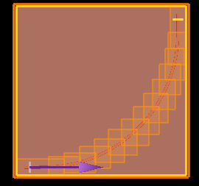
Problem Solving
Decrease stepping size
Mesh override
Low mesh res for the outside
High mesh res for features of interest
This method unfortunately is not viable because Lumeircal already performs non-uniform mesh optimization
We do not see a significant speed up…
0.1um (step) | Full | Segmented
dB | 0.035909 | 0.035909
Time | 2 min | 15 s
0.05um (step) | Full | Segmented
dB | 0.114669 | 0.114669
Time | 20 min | 18 min

